Slide 1
The lines will be muted…
To ask a question during the presentation, simply submit your question using the GoToWebinar program on your desktop.
Do Not Put Us On Hold During Intros!
Call this number 1-218-339-2620
723039# For Audio
If you can’t hear us—REDIAL
If you lose your connection—
Webinar ID 948-368-482
For any other questions, please email us at Info@dbmarketingsolutions.net

Slide 2
Minimize Control Panel
How to ask a question
Call this number 1-218-339-2620 723039# For Audio

Slide 3
Certified Financial Protection Group
“Using Forensic Loan Audits to Help Americans With Today’s Financial Crisis”
Presentation for Potential Associates

Slide 4
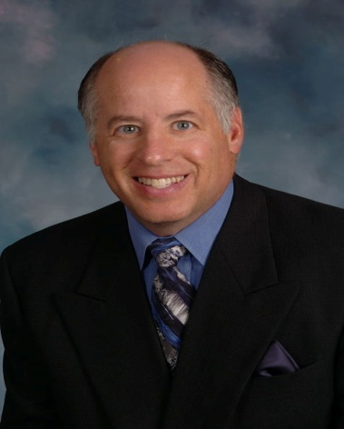
Your Host Today: Dave Hershman Top Industry Author and Speaker
Produced almost 600 transactions in his first 18 months in the industry—including closing 60 in his 12th month;
Run sales forces for large production organizations;
Directed the sales force for the largest mortgage technology organization;
Written seven books in the areas of finance, management, sales & marketing—including two best-sellers published by the MBA;
Helped found a Federal Bank, serving as a board of director;
Been a keynote speaker at hundreds of industry events
Guest Speakers: Len Babbitt,
Brian Fulkerson and David Grider of
The Certified Financial Protection Group

Slide 5
Our goals today
The crisis we all face today
What is a loan modification and why will banks modify
Who is Certified (CFPG)?
The process
Income potential of loan modifications
Becoming an Associate

Slide 6
The crisis we face today
The housing crisis is the most severe since the great depression
It has affected every practitioner’s ability to make a living
Loan modifications is a short-term market—but it is countercyclical to the real estate market-making it a great long-term strategy—producing referrals for your primary business as well.
The legal landscape for loan modifications is changing—and companies must change their models to adapt.
Most importantly—it will help your clients who need it the most when they need it the most.

Slide 7
Government Solutions not working
FHA lenders—did not use FHA HOPE program
Lender must cut equity to 94% of current value
Borrower must share future equity with FHA (not lender)—50% to 100%!
No second mortgages for five years
3.0% upfront MIP and 1.5% annually—plus regular closing costs
New Obama plan encourages modifications
Does not help those severely under-water
Does not help those who are investors or outside conforming limits
The program is voluntary: banks do not have to follow
Banks have admitted, they are not prepared for the volume.

Slide 8
What is a loan modification?
A loan modification can mean many things. The classic definition: “A Loan Modification is a permanent change in one or more of the terms of a mortgagor's loan that allows the loan to be reinstated.”
Modification actions may include--
Arrears repayment program
Interest rate reduction
Principle balance reduction
Converting to a secure fixed rate
Temporary modification that leads to permanent change in terms

Slide 9
Why are the banks willing to modify?
A lender might be open to modifying a loan because the cost of doing so is less than the cost of default. If a bank takes back a home in a foreclosure, they have to maintain it, insure it, and market it . . . until it sells.“
…and they still will take a loss on the principal. Because when it sells, it will sell at or below today’s current market price.

Slide 10
What is difficult or impossible to modify?
Client’s sole hardship is “too much debt”
Client shows a low debt-to-income ratio (too much income vs. expenses)
Fixed rate mortgages that are current (depending on the lender)
Client does not have a true hardship
Client’s sole hardship is “mortgage is more than the property is worth”
A modification has been done in the last 12 months
A trustee sale date has been set

Slide 11
THE COMPANY
Certified Financial Protection Group is the nation’s leading Forensic Audit and Loan Modification processing company. Our goal is to provide financial relief to borrowers facing hardship in the current economic turmoil. We are the only truly transparent processing company with our Associates’ and our clients’ best interests in mind. Integrity and customer service are the focus of our operation and our Associates are expected to uphold the same standards. We operate in all 50 states and work with every lender in the mortgage industry!

Slide 12
Company Background
History – in business since 2007 doing Forensic Audits and Loan Modifications.
Company headquartered in Temecula, CA
Website: www.FHA365.com (FHA stands for Forensic Home Audit).
We have helped over two thousand clients with Audits and Loan Modifications
Goal is to grow to handle a much larger volume
We believe in our Product. That includes a 100% refund policy.

Slide 13
Company Leadership
CEO – Mike Wayman - Background includes 15 years in law enforcement.
Operations Manager – Don Brokaw
Business Development – Dan Rish
Marketing Director – Len Babbitt
Team Support:
David Grider: Team Leader
Brian Fulkerson: Team Operations Manager
Dave Hershman: Training and Support. 30-year industry veteran and top author and speaker

Slide 14
The Vision of Certified
Non Profit. The principals of Certified are aligned for non-profit organization and are in final stages of certification with HUD. In the long run, Associates that sign up will have potential for training and take advantage of the non-profit umbrella which may include generation of business directly from lenders and the provision additional services including free stop sale dates. More information on this to follow.
Lead Generation. The company will generate leads that can be purchased and will assist in marketing for lead generation for higher producing Associates.
Future Products. Certified is strategically aligning themselves with other partners regarding credit repair, debt consolidation and other products that will be available to Associates .

Slide 15
Forensic Audit
The Fee charged includes this audit which is intended to lead to a loan modification. The government is advising consumers not to pay a fee up front for loan modifications.
A Forensic Audit is a report generated that examines the legal aspects of a homeowners mortgage documents.
Many audits report violations which makes the modification process easier as the bank is much more likely to listen when they are faced with a legal challenge.
Go to website www. FHA 365.com for a more detailed explanation of the report process and there is a sample audit in the Associate application package.
Note: Even if the client does not have their mortgage papers, we will track them down as part of the service.

Slide 16
Refund Policy
If no modification is offered, client can get a refund of 100% of what they paid.
This is a key ingredient. It helps the client take a very important step forward.
We will go one step further: If the client does not “accept” the modification, we will refund all but a $500 processing fee which is retained.
We will “front” the refund money, but the Associate must pay Certified the fee the Associate earned.

Slide 17
GETTING STARTED
There are only a few simple steps needed to ensure your success as a new Associate Member with Certified.
Log into the Certified weekly webinars and conference calls for updates on industry changes and marketing efforts to create new sales for our Associate Members—as well as training. These are held every Tuesday and Thursday and are recorded.
Log into the cutting edge back office system and complete the tutorial (we also have Fast Start training)
Create your web site using our template located in the back office system.
Utilize our marketing templates from the back office system.
Note: If you use these templates, you do not need to get approval of your marketing. You can use your name or ours on these. Other marketing materials used must be approved and we will help you develop materials as well.
Purchase leads from our Lead Management System or learn to capitalize on your own self-generated leads.

Slide 18
PLACING AN ORDER
ALL new Forensic Audit and Loan Modification orders will be able to be placed online through your personal web site shortly.
You will be able to log in 24/7 to view current status and track all accounting aspects of your files as well.
ALL client information is protected in our Information Safety Policy to prevent identity theft and ensure client privacy!

Slide 19
Responsibilities of Associate
Find prospects (we have lead generation programs).
Prequalify prospects. There are two aspects of pre-qualification:
They must have a hardship. This does not solely mean that their house has gone down in value. They must not be able to make their payment: either behind now or will soon get behind. Note: We NEVER advise people not to make payments.
They must qualify for a reduced payment. For example, if they are not employed they can’t qualify
Bank requirements change daily—we will keep you updated in twice per week calls that are recorded. There are no published guides and requirements may vary at each bank by each investor they deal with.
Get application filled out and payment procured. You don’t have to collect documents!
Let the client know what the process is and what to expect.
Uphold the ethics of the organization—including not bringing in clients by making promises that can’t be delivered.

Slide 20
GETTING PAID
Cash flow is often the biggest challenge for new business owners and Certified will solve this problem for YOU!
Certified is a processing company that pays its Associate Members as files are submitted with payment! This is the key to our success and also the key to YOUR success.
We have created a system that allows you to simply submit the application and WE HANDLE THE REST! Our staff will collect all of the necessary financial documents and provide your clients with weekly updates throughout the entire process. Once you submit the application with payment, WE handle the rest!
Note: If you have collected documents, please forward with the file (they can be scanned), but do not hold file up for uncollected documents. We don’t want to be calling the client for documents they already have given you.
We pay our Associate Members on the 2nd and 4th Friday of each month. Cut off time is 2:00 pm pacific time on the 1st and 3rd Friday— which means application received and payment cleared. Goal is to transition to a weekly payment as well as going to a direct deposit.

Slide 21
RESIDUAL INCOME
Certified is the only processing company that allows you to grow your business by adding Associate Members under you and receiving compensation for EACH file that they submit.
The reality is that almost every American in every city across the nation needs this service, and you cannot do it all yourself. We allow you to reach out to others in your network and set them up on the exact same system as an Associate Member. For each member that signs up under you, you receive a $200 PER FILE override. This system has four levels and the compensation potential is endless!
You can protect present employees from signing on directly by submitting a list of these to us.

Slide 22
GROWING YOUR NETWORK
YOU
Associate Member that you sign up
$200 per file paid to YOU
Associate Member that they sign up
$200 per file to them and $100 per file paid to YOU
LEVEL 1
($200 per file)
LEVEL 2
($100 per file)
LEVEL 3
($50 per file)
Associate Member that they sign up
$50 per file paid to YOU
LEVEL 4
($25 per file)
Associate Member that they sign up
$25 per file paid to YOU

Slide 23
THE SCENARIO
If you submit 5 deals a month you will gross approximately $7500…
If you have 5 brokers under you doing the same volume you gross another $5000…
If they have 5 brokers under them with the same volume you gross another $2500…
If they have 5 brokers under them with the same volume you gross another $625…
This basic scenario produces $15,625 per month.
The numbers grow exponentially from here without limit and our bonus program allows up to $250,000 per quarter in bonuses!
THE POSSIBILITIES ARE TRULY ENDLESS!

Slide 24
FEES
Associate Members are permitted to charge any fee to the client . Average fee to clients for the Forensic Audit and Loan modification of their first and second mortgages is $2995.00 and this is also the recommended price.
The fee goes directly to Certified. This means that you don’t have to handle the money or have to deal with compliance issues.
Associate Members receive all fees over $1500 for processing by Certified. There is no charge for the second mortgage.
There is an additional $500 base fee for sale date that is within 14 days (non-judicial states). This allows for a second negotiation on a priority basis. This additional fee is also refundable if we fail to stop the sale and therefore achieve a modification.
The client can pay in two payments, 30 days apart. Your fees will be adjusted accordingly.
Note: In order for all clients not to choose the payment plan, many our Associates quote a higher fee for this option.
There is a 3.0% fee which is a reduction in revenue to the Associate for processing of credit cards, debit cards or ACH transfers.

Slide 25
Monthly Bonus Program
Monthly Associate Incentive Bonus
*Based Upon Calendar Month
10+ Files…………………………………$250
25+ Files…………………………………$875
50+ Files……………………………….$2,500
100+ Files………………………….......$7,500
200+ Files…………………………….$20,000
500+ Files…………………………….$62,500
Total Team Monthly Incentive Bonus
100+ Files……………………………...$2,500
200+ Files……………………………...$5,000
500+ Files…………………………….$17,500
1000+ Files…………………………...$50,000
Wait—
There is More!
Monthly bonuses based upon personal and team production

Slide 26
Quarterly Bonus Program
And
Even More!
Quarterly bonuses based upon personal and team production
Quarterly Associate Incentive Bonus
*Based Upon Calendar Quarter
100+ Files……………………………...$2,500
200+ Files……………………………...$5,000
500+ Files…………………………….$17,500
1000+ Files…………………………...$50,000
Total Team Quarterly Incentive Bonus
250+ Files……………………………...$6,250
500+ Files…………………………….$15,000
1000+ Files…………………………...$35,000
2500+ Files………………………….$100,000
5000+ Files………………………….$250,000

Slide 27
The Advantages of Certified
No retail presence so you are not competing with in the same company
Ability to sign up other Associates and earn residual income . Webinars and support to help you do just that.
Not charging for Loan Modification but a Forensic Loan Audit which gives you leverage. A 100% refund policy
No charge for 2nd mortgage on same property
Don’t have to collect paperwork—we do the total processing
Technology
Fully functional replicated website
Applications and customer service updates on-line (in test stage now)
Tracking of down line using the same network marketing software as multi-billion dollar companies
Potential for non-profit affiliation in the future.
Marketing materials available on the back office include flyers, door hangers, consumer slide presentation and even retail website templates
Training program—fast start, sales and more
Lower cost lead generation program coming

Slide 28
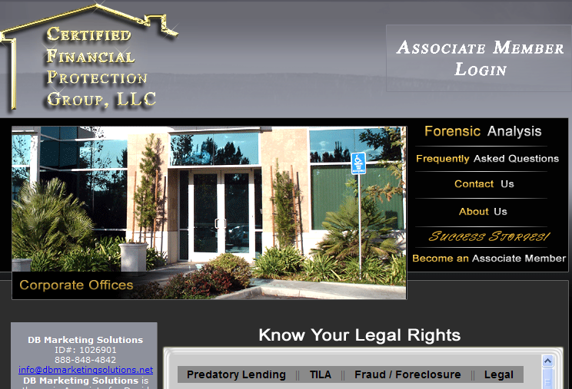
Replicated Website

Slide 29
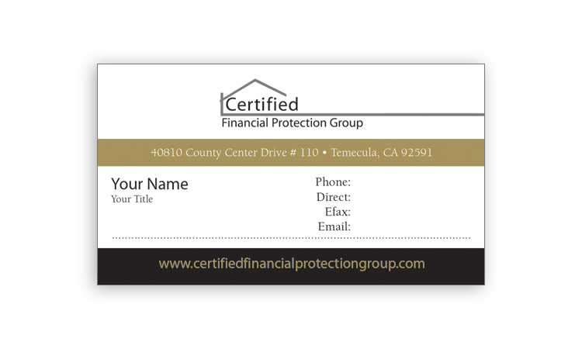
Marketing

Slide 30
Marketing

Slide 31
Benefits of Signing up NOW
April Bonus of $50.00 for every file sent in
Also in April an additional Bonus of $100 for every file paid by check, money order or cashiers check
Up-front cost is $99.00 but if you sign up before April 30th, the $99 will be refunded on the 15th of the following month after your first deal is submitted.
Monthly cost is $49.99 which includes the replicated website, customer service software, downline tracking system, training and more.

Slide 32
CONTACT US
Please do not hesitate to contact our Associate Member Success Team with any questions that you have along the way. We are here to help you and our success depends solely on YOUR success!
You are supported the same whether you are level 1 or level 6 on our team.
You can reach us by emailing your questions to Info@dbmarketingsolutions.net or calling our office at 888-848-4842. If you are referred by one of our Associates—please go to their website to sign up. We are all part of the same team!
Our website is dbmarketingsolutions.net.

