Slide 1
The lines will be muted…
To ask a question during the presentation, simply submit your question using the GoToWebinar program on your desktop.
Do Not Put Us On Hold During Intros!
Call this number 1-702-589-8200
723039# For Audio
If you can’t hear us—REDIAL
If you lose your connection—
Webinar ID 497-374-898
For any other questions, please email us at info@financialhopeforyou.org

Slide 2
Minimize Control Panel
How to ask a question
Call this number 1-702-589-8200 723039# For Audio

Slide 3
“Using a Non-Profit Model to
Help Americans With Today’s Financial Crisis”
Presentation for Potential
Non-Profit Chapters

Slide 4
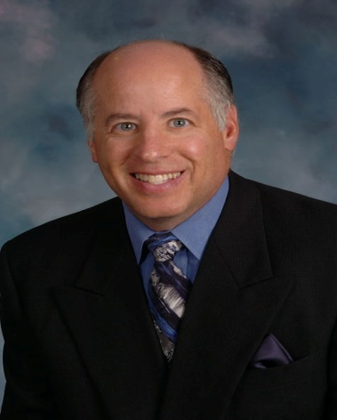
Your Host Today: Dave Hershman Top Industry Author and Speaker
Produced almost 600 transactions in his first 18 months in the industry
Run sales forces for large production organizations;
Written seven books in the areas of finance, management, sales & marketing—including two best-sellers published by the MBA;
Been a keynote speaker at hundreds of industry events
Guest Speakers: Len Babbitt, Dan Rish
Brian Fulkerson and David Grider of
Financial Hope For America

Slide 5
Our goals today
The crisis we all face today
The government’s involvement
What is a loan modification and why will banks modify
Who is FH4A
The benefits of becoming a Chapter
The process
Income potential
Becoming a Chapter
Question and Answer Session

Slide 6
The crisis we face today
The housing crisis is the most severe since the great depression
Over one million have already lost their homes this year and millions more will follow.
Loan modifications represent a short-term market—but it is countercyclical to the real estate market-making it a great long-term strategy—producing referrals for your primary business as well.
The legal landscape for loan modifications is changing—and companies must change their models to adapt.
Most importantly—it will help your clients who need it the most when they need it the most.

Slide 7
Government Solutions not working
Lenders will not use FHA HOPE program
Lender must cut equity to 94% of current value
Borrower must share future equity with FHA (not lender)—50% to 100%!
3.0% upfront MIP and 1.5% annually—plus regular closing costs puts the tab at 20% of the balance for a ten year period.
New Obama plan encourages modifications
Does not help those severely under-water
Does not help those who are investors or outside conforming limits
The program is voluntary: banks do not have to follow
Banks have admitted, they are not prepared for the volume
The program does not preclude homeowners being represented

Slide 8
The Present Problem With Mods
Those who are losing their home do not have thousands up-front to pay for a loan modification
The number one objection is, “I don’t have the money”
The government is advising prospects not to pay the money
Scams have proliferated across the nation
Non-profits that the government are referring people to lack funding and are thus ineffective.
State governments are rushing to regulate/close down loan mod companies because of the bad publicity
If people want to go it alone—banks are not responding.
Loan mod income is transactional and will not last forever.
We present a solution for all of these issues.

Slide 9
What is a loan modification?
A loan modification can mean many things. The classic definition: “A Loan Modification is a permanent change in one or more of the terms of a mortgagor's loan that allows the loan to be reinstated.”
Modification actions may include--
Arrears repayment program
Interest rate reduction
Principle balance reduction
Converting to a secure fixed rate
Temporary modification that leads to permanent change in terms

Slide 10
Why are the banks willing to modify?
A lender might be open to modifying a loan because the cost of doing so is less than the cost of default. If a bank takes back a home in a foreclosure, they have to maintain it, insure it, and market it . . . until it sells.“
…and they still will take a loss on the principal. Because when it sells, it will sell at or below today’s current market price.
In addition, the government is pressuring banks to modify their loans.

Slide 11
Company Background
The Certified Financial Protection Group was formed in 2007 in Temecula, CA with a focus of providing processing services for Forensic Audits that lead to loan modifications (Website: www.FHA365.com -- FHA for Forensic Home Audit).
CFPG has been incredibly successful, helping over two thousand clients with Audits and Loan Modifications, all on a wholesale basis. There is now over 90 employees and the company encourages personal tours of the office from Monday through Thursday.
Company recognized the aforementioned issues with regard to originating loan modifications
With the future in mind, in mid-2008 CFPG began working with the government, accountants and lawyers on the non-profit model—spending thousands man-hours and investing tens of thousands of dollars in building a structure. The company is currently working on HUD certification. Financial Hope For America site: www.FH4A.org
Note: the organizations CFPG & FH4A are separate & must remain so for legal purposes. You can participate in either model or both.

Slide 12
Non-Profit Leadership
CEO – Mike Wayman - Background includes 15 years in law enforcement.
Operations Manager – Don Brokaw
Business Development – Dan Rish
Marketing Director – Len Babbitt
Chapter Support:
David Grider: Team Leader
Brian Fulkerson: Team Operations Manager
Dave Hershman: Training and Support
Advisory Board: As a national non-profit organization, there will be a high-level advisory board with nationally recognized names that are associated with the organization.

Slide 13
Benefits of Becoming a Chapter With FH4A
Credibility of being a Chapter of a non-profit organization. Non-profits are by virtue of their charters in existence to benefit the public good. This is potential leverage with banks as well.
Immediate FREE Halt Sale for Clients
Affordable $495 sign-up and $199 monthly membership fees for members—this includes the loan modification
Membership fees are tax deductible
Membership includes a large variety of important and beneficial services
Chapters can earn multiple streams of income which may continue after the modification is delivered
No processing paperwork by Chapters—FH4A does it all
24/7 online Client tracking software and replicated websites

Slide 14
FH4A is not a loan mod company
A non profit organization
FH4A will provide a series of services to members as part of membership. These services are designed to attack the issues Americans face.
Loan modification (one provided for the primary residence as part of membership).
Debt settlement services
Credit improvement services
Short sale/leaseback programs and more (see later slide)
Service providers are selected on the basis of being national in scope, compliant in their area of service, have a minimum of five years of service and a track record of producing results.

Slide 15
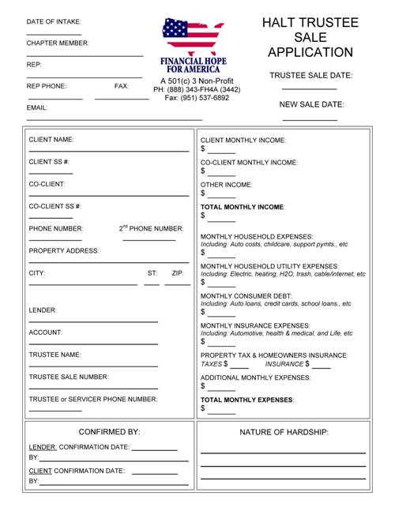

Slide 16
Free “Halt Sale” Service
Now you can deliver a free service needed by any homeowner who is in trouble.
This service is delivered only for prospective clients of FH4A Chapters for their primary residences.
All you need to do is get the form filled out.
FH4A immediately contacts Client, reviews info. w/Client and sets up 3-way call w/Lender to stop the sale
Mitigator stops sale with Lender and gets confirmation
Client is instructed to confirm stop sale with Lender and to contact Mitigator with confirmation receipt
CSR Mgr. returns the Halt Sale form to the Chapter
Chapter then contacts Client to present the benefits of membership with FH4A

Slide 17
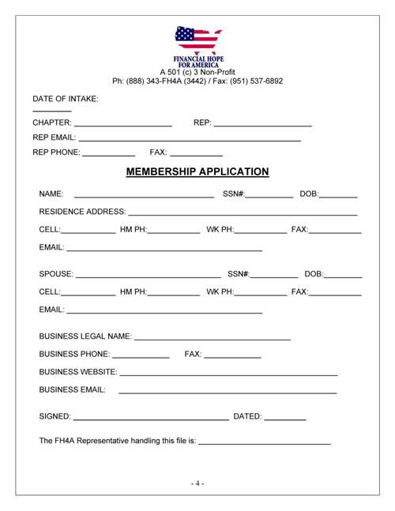

Slide 18
Membership Procedures
Membership application is delivered to CSR Mgr.
CSR Mgr. sends email confirmation of receipt to Chapter
CSR Mgr. delivers application to accounting
Accounting processes payment, enters Client’s info into tracking software, and prepares the file for intake
File is received by Intake Mgr. who then assigns the file to an intake specialist
The intake specialist contacts the Client and delivers the Document Request forms via email or fax
Normal processing then begins– no documents need to be procured by Chapter. Still make sure you are prequalifying—which means they need to have a hardship and can afford the reduced payment.

Slide 20
Gift Contribution
FH4A Membership can only provide loan modification for primary residence
Additional properties --or the first property if they only own an investment property--are handled by a ‘gift” from the member to FH4A
The amount of the gift is $400 per month for six months.
Note: They have to be a member, plus pay the cost of the gift—so you would add this to the regular membership fee.

Slide 21
Loan workout mitigation
Homebuyer education program
Mortgage delinquency & default resolution consulting
Equity acceleration consulting
Predatory lending consulting
Short Sale negotiations
Property tax reduction
Renters assistance
Fair housing assistance
Home equity conversion (Reverse Mortgages)
Pre & post purchase consulting
Services Are The Key To Retention: Housing Assistance

Slide 22
Additional Services and Education:
Debt, Credit & Financial Services
Debt elimination and resolution consulting
Credit reconstruction & repair
Credit score repair
Credit consulting (not Consumer Credit Counseling or CCC)
Financial planning
Estate planning
Money debt management
Asset protection
Outreach initiatives
Small business consulting
Insurance services

Slide 23
Before We Introduce The Revenue Model
Remember that loan modifications are a short-term revenue opportunity
The provision of over 20 points of education and services will give us the ability to retain clients for the long term.
Some of the services will be self-help, others will be links to professional services which will have the potential to produce even more income for the Chapters.
FH4A will be proactive in this regard, getting the members involved in needed services after the referral. Once again, no work need be done by the Chapter.
The Organization is taking a good portion of the revenue and diverting to Chapters, instead of investing in advertising. The sole function of Chapters is to bring in qualified Members.

Slide 24
Revenue Summary: Membership Fee
First point: Do not think that non-profit means no revenue to the Chapters. Even the additional services may provide additional revenue to members.
Initial Membership fee of $495 of which $245 is distributed to Chapter Members
Monthly Membership fee of $199 of which $99 is distributed to Chapter Members
Retention for four months: Total income is $641
Retention for five years: over $6,000!
100 Members? $9,900 per month--
and that is residual! (month after month)

Slide 25
7 Level Matrix
$50 From the $250 Up-Front Fees Collected:
LEVEL ONE $20 40% 1,000 members
LEVEL TWO $10 20% brought in this
LEVEL THREE $8 16% year by “team”?
LEVEL FOUR $6 12% $6,000 to $10,000
LEVEL FIVE $3 6% in income.
LEVEL SIX $2 4%
LEVEL SEVEN $1 2%
TOTAL $50 100%

Slide 26
7 Level Matrix
$20 From the $199 Monthly Fees Collected
LEVEL ONE $6 30% Example: 1,000
LEVEL TWO $4 20% members referred
LEVEL THREE $3 15% by team?
LEVEL FOUR $2 10% Income $2,000
LEVEL FIVE $2 10% to $4,000--
LEVEL SIX $2 10% monthly!
LEVEL SEVEN $1 5%
TOTAL $20 100%

Slide 27
INCENTIVE PRODUCTION BONUS - MONTHLY
PERSONAL 10+ APPLICATIONS $50
25+ APPLICATIONS $100
50+ APPLICATIONS $350
100+ APPLICATIONS $1,000
TEAM 100+ APPLICATIONS $1,000
200+ APPLICATIONS $2,400
500+ APPLICATIONS $7,500
2,500+ APPLICATIONS $50,000
Note: Bonuses are in addition to aforementioned residual and commission
Team production is credited to all levels down (not limited to 7)

Slide 28
INCENTIVE PRODUCTION BONUS - QUARTERLY
PERSONAL 500+ APPLICATIONS $7,500
1,000+ APPLICATIONS $17,500
2,500+ APPLICATIONS $50,000
5,000+ APPLICATIONS $100,000
TEAM 2,500+ APPLICATIONS $50,000
5,000+ APPLICATIONS $100,000
10,000+ APPLICATIONS $200,000
25,000+ APPLICATIONS $625,000
50,000+ APPLICATIONS $1,250,000!

Slide 29
Additional Services That Could Provide Revenue
Debt settlement: 70% of the fees produced go to FH4A
Credit repair: Enrollment fees and monthly fees as well
Property tax reduction
Short sale/leaseback (available only in California for now)
Mortgage insurance reduction
More coming
Formula: Fees brought into FH4A
shared “50-50” with Chapters

Slide 30
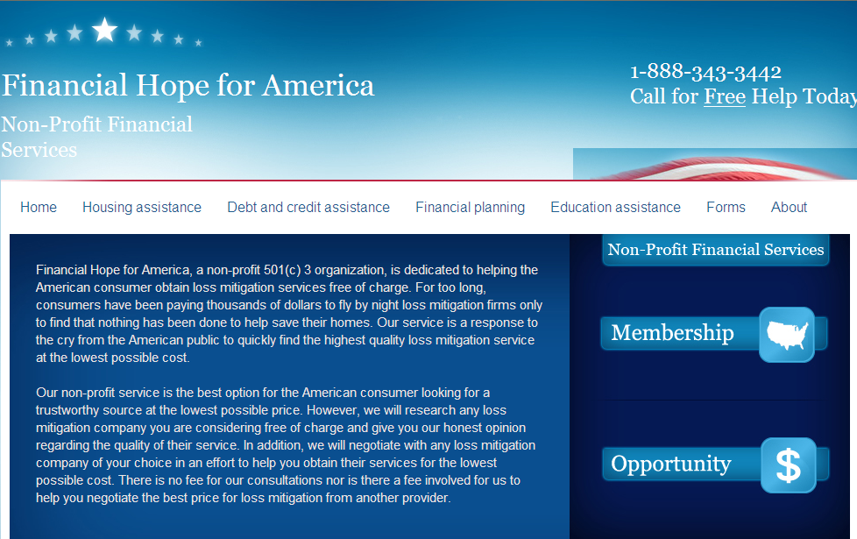
Replicated Website

Slide 31
Marketing Materials

Slide 32
Marketing Materials

Slide 33
Signing up as a Chapter
Cost is $1,495 up-front and $79 monthly
You will get a replicated website & access to a complete line of professional marketing and promotional materials
Contact the Chapter that referred you
If you received an email from Dave Hershman and/or OriginationPro and were not referred directly by a Chapter, I am supporting DB Marketing Solutions (last slide)
Major benefit of signing up now: The Non-Profit Chapters that join now, the $1,495 fee will be waived. The monthly fee is not charged until 30 days after enrollment. However, members can be referred immediately.
Basically you join now for no immediate cost!

Slide 34
One More Point
The model of CFPG is still in effect until it is proven to be legally not feasible in your State.
This means those who want to join CFPG can still do so.
Cost is $99 up-front and $49 monthly. CFPG provides complete processing, marketing and technology support.
We provide forensic loan audits that lead to a loan modification with results guaranteed at a recommended price of $2,995, $1,495 is income to you. Note: FH4A does not do forensic audits.
There are no free halt sale services. CFPG charges $500
There is a recruiting/multi-level component to this as well—4 levels
Contact info@financialhopeforyou.org (last slide) or the Associate Member who referred you if you want to participate in this model.
You can participate in CFPG and FH4A both, or one or the other.
One Restriction: You cannot solicit clients for the non-profit model and “switch” them to the fee (CFPG) model.

Slide 35
Contact Us
Please do not hesitate to contact our Chapter Success Team with any questions that you have along the way. We are here to help you and our success depends solely on YOUR success!
You are supported the same whether you are level 1 or level 7 on our team.
You can reach us by emailing your questions to Info@financialhopeforyou.org or calling our office at 888-848-4842. This includes OriginationPro/Dave Hershman referrals. Dave Hershman is dave@hershmangroup.com
If you are referred by one of our Chapters—please go to their website to sign up. We are all part of the same team!
.

